Slide 1
Software Developer Agile Software Development The SDLC

Slide 2

What is systems development?
The process of taking a set of business requirements through a series of structured stages and translating them into an operational IT system.
Let’s see what these structured stages are …
Notes:
Systems Development is “The process of taking a set of business requirements through a series of structured stages and translating them into an operational IT system.” From the ‘Developing Information Systems’ book.

Slide 3
What is a systems development life cycle?
A system development life cycle (SDLC) is a framework describing a process to:
understand
plan
build
test
deploy
an information system.
Can apply to:
Hardware
Software
Both
Feasibility study
Requirements analysis
Design
Code development
Testing
Deployment / implementation
Maintenance
Notes:
In any systems development there are a number of stages that must be undertaken. These are shown as sequential steps although they do not have to be as we shall see when we consider different lifecycles.
The main stages vary dependent on the systems development approach being used but typically include:
Feasibility Study – Why do we need the system?
Requirements Analysis – What does the system need to do?
Design – How will the system and components be built?
Code Development – Construct system to meet requirements
Testing – Checks system does what it should do and how it should do it
Deployment / Implementation – Deploys the system in the live or production or operational environment
Maintenance – Support the live system.

Slide 4
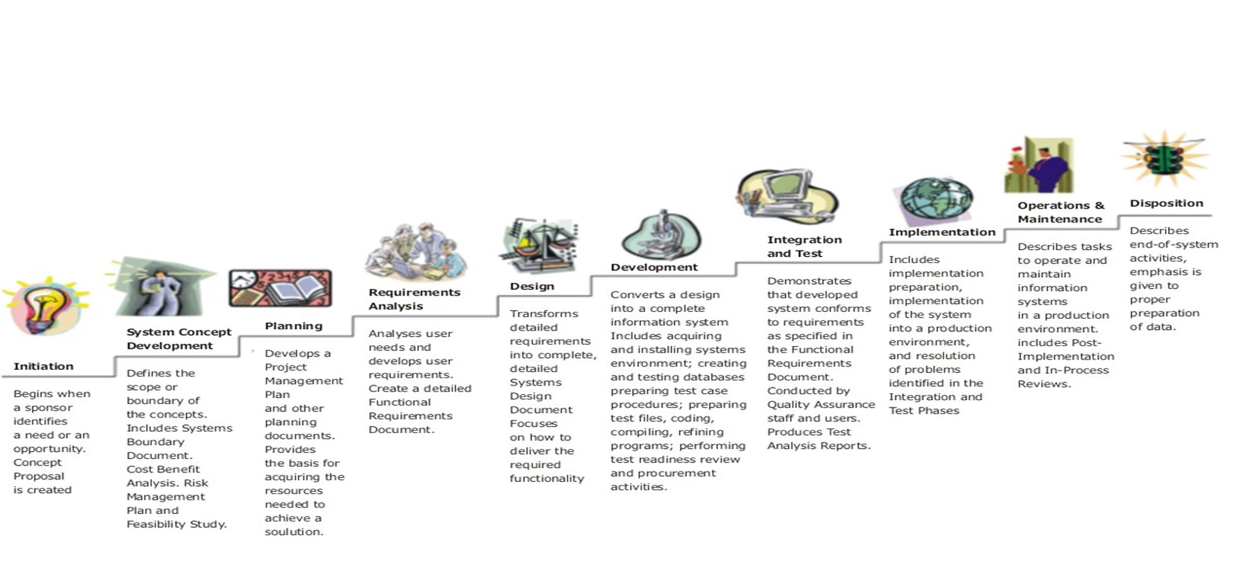
Life cycle phases
Notes:
A more detailed breakdown is illustrated in the diagram consisting of:
Initiation – Sponsor identifies need or opportunity.
Systems Concept and Development – Define scope, boundaries and business case for system.
Planning – Develop plan and calculate resources needed to build system.
Requirements Analysis – Capture user and business needs for the system.
Design – How the system will deliver the requirements.
Development – All activities to convert design into a working system.
Integration and Test – Confirm system meets requirements.
Implementation – Preparation and deployment of the system.
Operations and Maintenance – Tasks to support live operation of the system.
Disposition – End of system activities.

Slide 5
Feasibility (initiation) study
Feasibility study
Funding required before starting.
Evaluate benefits and likelihood of success.
Resources and costs versus value of completed system:
Business case
Return on investment (ROI)
Time dependent on size and complexity of project.
Requirements analysis
Design
Code development
Testing
Deployment / implementation
Maintenance
Notes:
The first stage of any system development should be a Feasibility Study. This calculates the funding required before starting any work by investigating, researching, evaluating benefits and the likelihood of success of the system. An understanding of the resources and costs versus the value of completed system is completed and captured in the Business Case. A key measurement is the Return on Investment (ROI) of the system. The estimated time for the project, dependent on its size and complexity, is also determined.
This stage is also known as Initiation.

Slide 6
Requirement analysis
Feasibility study
What business needs proposed system to do.
Ask if unsure.
Elicit, analyse, document, and validate requirements.
Decide how to store, manage, access, and update requirements.
Key input to design; requirements traced through SDLC.
Level of detail influenced by SDLC.
Also known as requirements engineering.
Requirements analysis
Design
Code development
Testing
Deployment / implementation
Maintenance
Notes:
Next stage is Requirements Analysis in which an understanding of what business needs proposed system to do is captured. Business Analysts elicit, analyse, document and validate requirements from the sponsors, business, users and customers as appropriate. A method and process is needed to store, manage, access and update the requirements. This is a key input to design as the requirements are traced through SDLC. The level of detail required is influenced by the SDLC used.
This stage is also known as Requirements Engineering.

Slide 7
The importance of good requirements
What do you think is the consequence of badly/poorly designed system requirements?
Notes:
The following are characteristics of a good requirement:
Categorised – Grouped by type of requirement to make easier to review.
Relevant –
Prioritised – Relative importance specified.
Achievable –of the project.
Understandable and unambiguous – Consistent meaning among all stakeholders.
Testable – Possible to define a test with a pass or fail criteria to determine if the requirement has been met or not.
Requirement not solution – Defines the issue or need not how to address it.
Consistent – Make concise and not conflict with other requirements.
Owned –about its relevance and content.
Unique and atomic – Singular and not multiple requirements.
Traceable –and what happened to it.
Concise – Make as brief as possible whilst meeting other quality criteria.

Slide 8
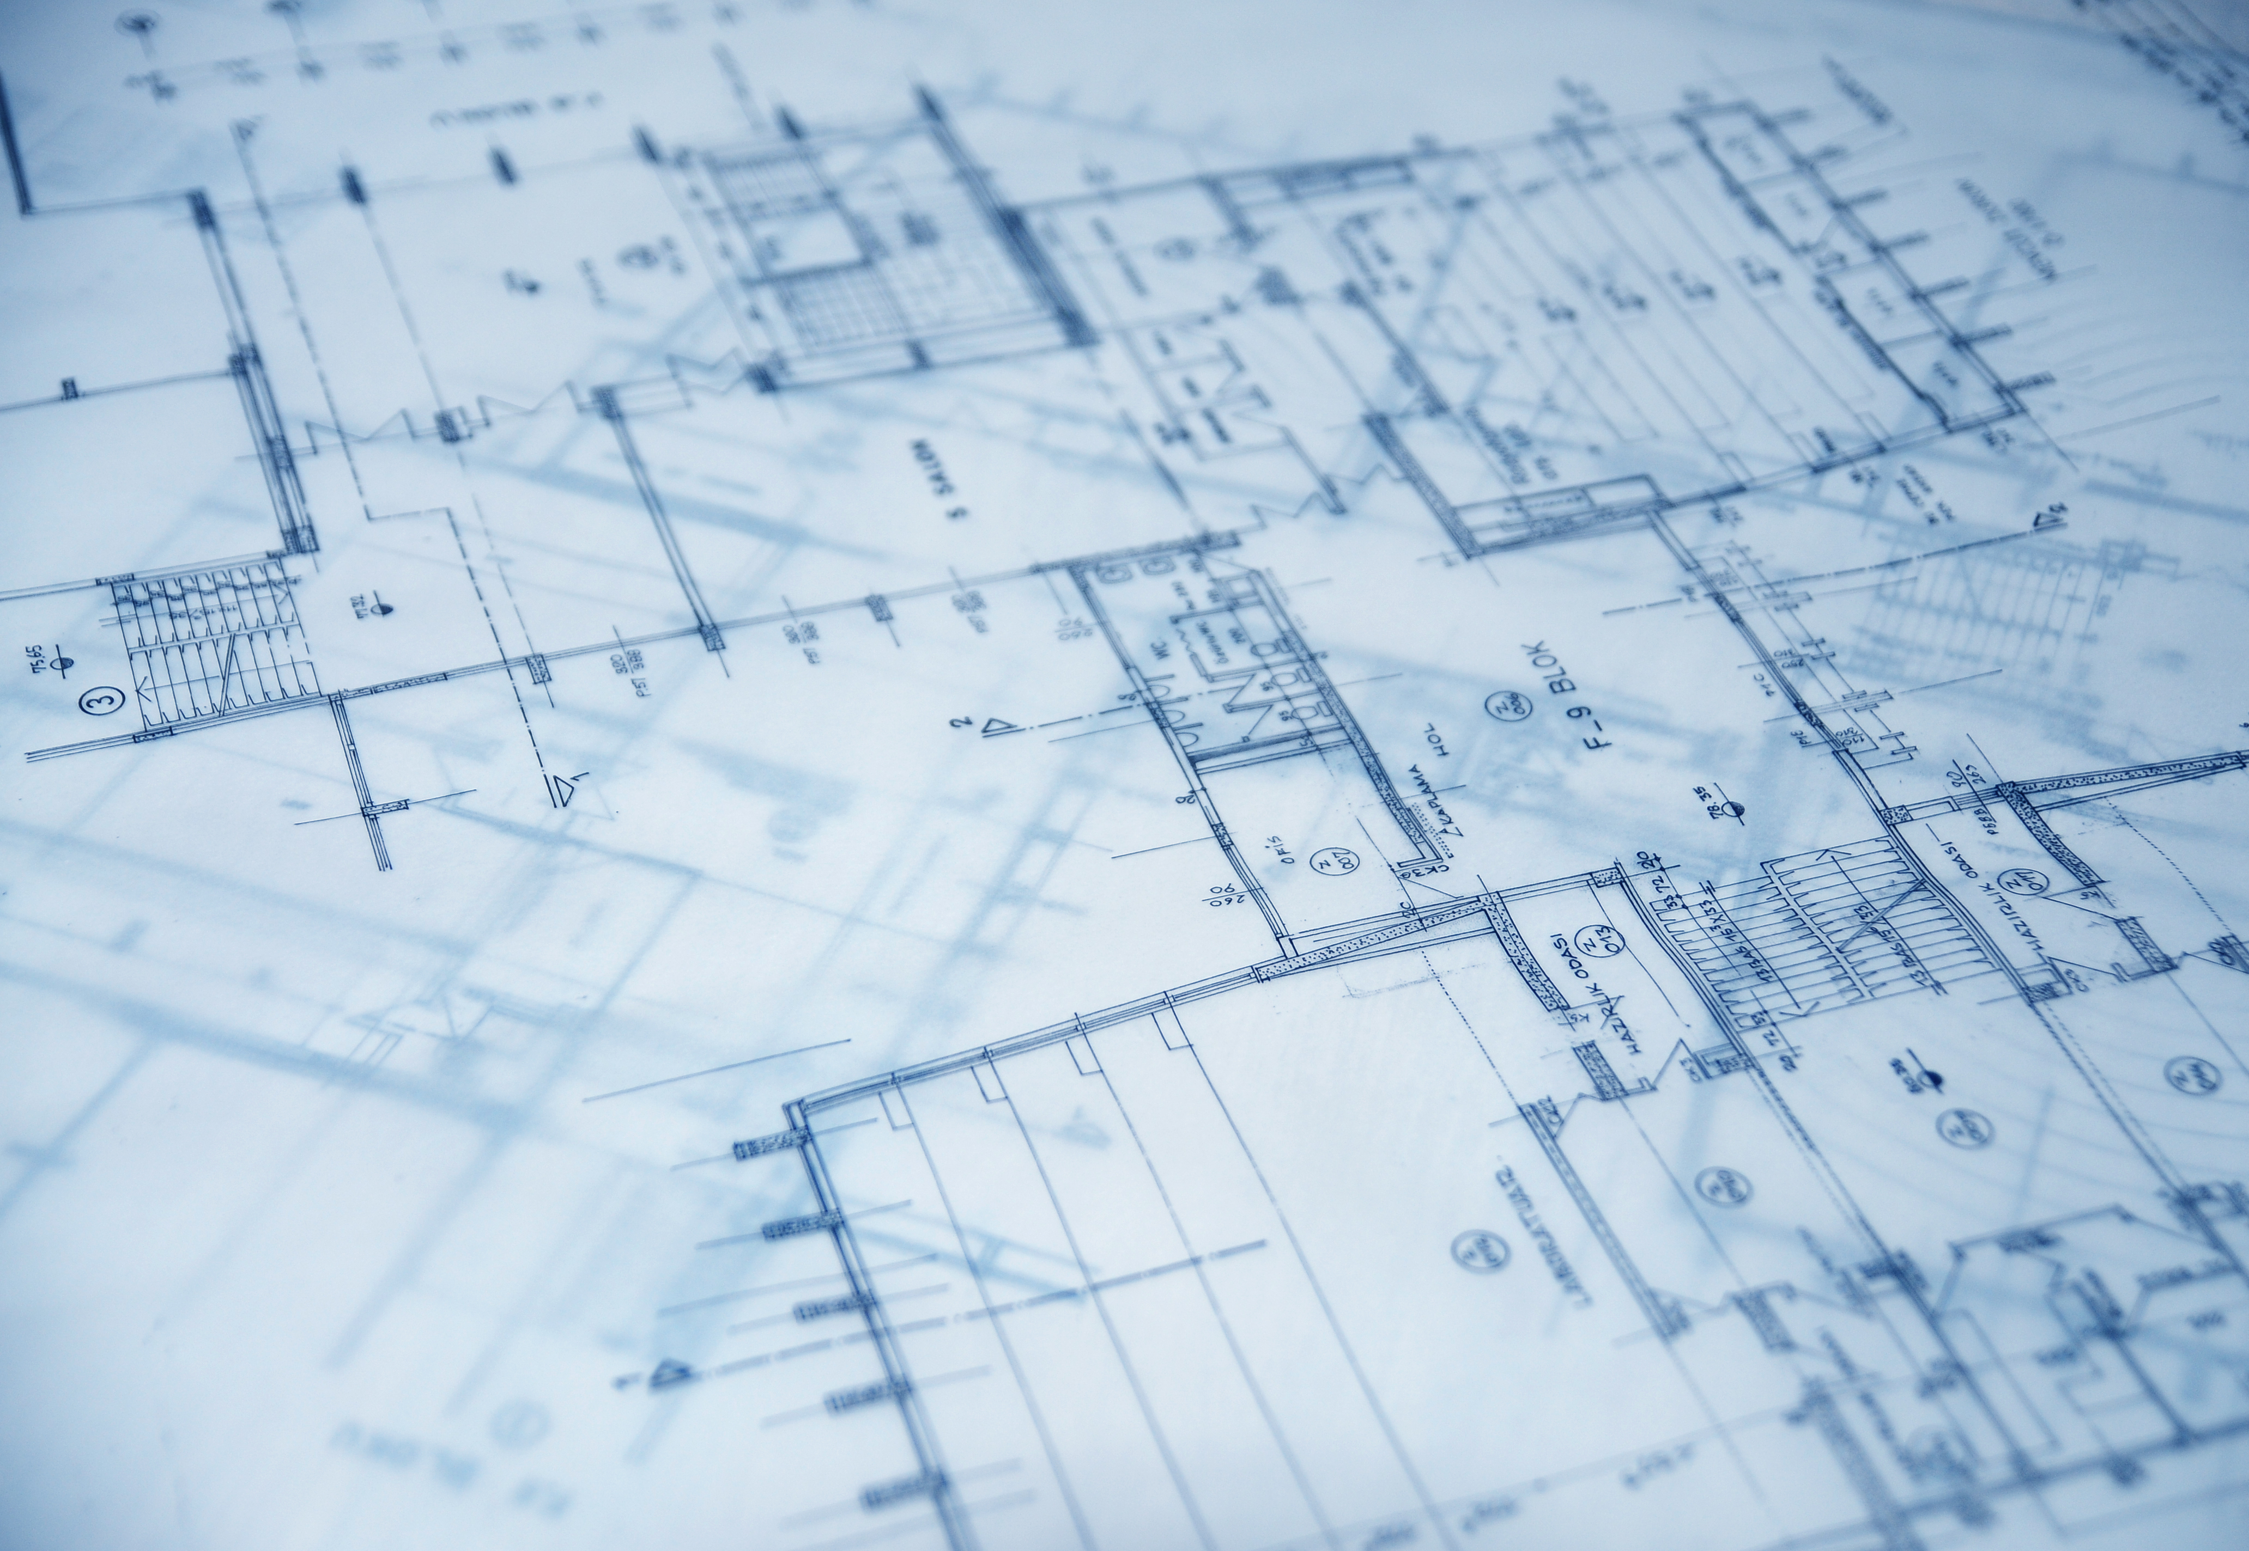


Characteristics of good requirements
Categorised Relevant Prioritised Achievable Unambiguous Testable Requirement not solution | Grouped by type of requirement to make easier to review Within scope of the project. Within the technical or budget constraints Unambiguous and clearly expressed
Notes:
The following are characteristics of a good requirement:
Categorised – Grouped by type of requirement to make easier to review.
Relevant –
Prioritised – Relative importance specified.
Achievable –of the project.
Understandable and unambiguous – Consistent meaning among all stakeholders.
Testable – Possible to define a test with a pass or fail criteria to determine if the requirement has been met or not.
Requirement not solution – Defines the issue or need not how to address it.
Consistent – Make concise and not conflict with other requirements.
Owned –about its relevance and content.
Unique and atomic – Singular and not multiple requirements.
Traceable –and what happened to it.
Concise – Make as brief as possible whilst meeting other quality criteria.

Slide 9

Characteristics of good requirements
Consistent Owned Unique and atomic Traceable Conformant | No conflict with other requirements By someone who can make decisions About one thing Where requirement came, where to go for more info Meets standards of how requirements should be documented
Notes:
The following are characteristics of a good requirement:
Categorised – Grouped by type of requirement to make easier to review.
Relevant –
Prioritised – Relative importance specified.
Achievable –of the project.
Understandable and unambiguous – Consistent meaning among all stakeholders.
Testable – Possible to define a test with a pass or fail criteria to determine if the requirement has been met or not.
Requirement not solution – Defines the issue or need not how to address it.
Consistent – Make concise and not conflict with other requirements.
Owned –about its relevance and content.
Unique and atomic – Singular and not multiple requirements.
Traceable –and what happened to it.
Concise – Make as brief as possible whilst meeting other quality criteria.

Slide 10
Requirement Classification
Functional
Define what the solution must do
For example to identify an invoice is overdue and issue alert
Non-Functional
Define how the solution must operate (product qualities)
For example the result of a query must be displayed with two seconds of pressing enter
General
High-level overarching requirements of a business policy nature
For example to comply with data protection
Technical
High-level overarching requirements of a technical policy nature
For example to operate on a certain platform and use a particular programming language
Notes:
Various schemes have been used to classify requirements. A common approach is:
Functional – These define what the solution is expected to do; For example to identify an invoice is overdue and issue alert.
Non-Functional – These define how the solution should operate or the product qualities; For example the result of a query must be displayed with two seconds of pressing enter.
General – High-level overarching requirements of a business policy nature; For example to comply with data protection legislation.
Technical – High-level overarching requirements of a technical policy nature; For example to operate on a certain platform and to use a particular programming language.

Slide 11

Functional Requirements - categories
Is What the system is expected to do
Data entry – Gathering and recording data
Data maintenance Changes to data, including data deletion
Procedural – Implementation of business rules
Retrieval – Reporting, responding to enquiries
Notes:
Functional requirements can also be classified as:
Data entry – Gathering and recording data
Data maintenance – Changes to data, including data deletion
Procedural – Implementation of business rules
Retrieval – Reporting, responding to enquiries

Slide 12
Non-functional requirements
Define constraints on how the functional requirements will be provided
Factors in the cost and are very important to the success of the product
Define a characteristic we must implement
Notes:
Non-function requirements define constraints on how the functional requirements will be provided. They can be a major factors in the cost of the product and are very important to the success of the product. They should something the product must be or define a characteristic it must have.

Slide 13

Non-functional requirements
Availability - System is available when required to fulfil its purpose
E.g. Reprint the report on demand This is an availability constraint – When this functionality must be available
Capacity - Supports transaction and other data volumes as necessary
Throughput – Relates to data/transactional volumes within a specific timeframe
E.g. Respond to a credit enquiry within 5 seconds. This is a performance constraint
Scalability - Scale up/down the number of transactions or users
Reliable – System is robust and available as defined by SLA.
Maintainability - How easy to fix/change – Designed well, flexible, well-documented

Slide 14
Non-functional requirements types
User-friendly Functionality delivered in a consistent, intuitive way.
Secure Adequate controls to restrict access to the system and its data.
Accessible Is accessible to all users regardless of disability, language…
Responsive Provides a response to a particular request within a timeframe.
Flexible Adapt to changing business situations.
Portable Can ‘port’ the design to different technology platforms/devices.
Configurable Can change the behaviour by setting configuration options

Slide 15
Design
Feasibility study
Evaluate possible solutions that meet requirements.
Chosen design elaborated to sufficient detail to start development.
Requirements analysis
Design
Code development
Testing
Deployment / implementation
Maintenance
Notes:
The Design stage evaluate possible solutions that meet the requirements. The chosen design is elaborated to sufficient detail to enable development to start.

Slide 16
Code development
Feasibility study
Hardware and software technical components created, procured or configured
Follow design to ensure system does what is required
Also known as programming or build.
Requirements analysis
Design
Code development
Testing
Deployment / implementation
Maintenance
Notes:
Development is when the hardware and software technical components are created, procured or configured. The design is followed to ensure the system does what is required.
This stage is also known as Programming or Build.

Slide 17
Testing
Feasibility study
Components produced tested to ensure working properly and does what supposed to do.
Different levels of testing:
Unit
Integration
System
User acceptance
Requirements analysis
Design
Code development
Testing
Deployment / implementation
Maintenance
Notes:
The next stage is Testing when the components produced during Development are tested to ensure they are working properly and do what they are supposed to do. There are several different levels and types of testing including:
Unit – Check individual components meet their requirements.
Integration – Ensure the checked components communicate and interface correctly.
System – Test the completed system performs the required end-to-end functionality.
User Acceptance – The user or customer tests the system from a business perspective.

Slide 18
Deployment / implementation
Feasibility study
Commissioning in a live environment:
Also known as operation or production environment.
Developed in test environment to protect live systems.
Needs to be carefully planned, understood, and managed.
Requirements analysis
Design
Code development
Testing
Deployment / implementation
Maintenance
Notes:
The penultimate stage is Implementation. The completed system needs to be commissioned or deployed in the ‘live’ environment; also known as operation or production environment. The systems is developed in a ‘test’ environment to protect the ‘live’ systems. This needs to be carefully planned, understood and managed to minimise any possible disruption to the business.

Slide 19
Maintenance
Feasibility study
More than just correcting faults or keeping the system in good running order:
20% corrective
80% enhancements
Depends on:
development strategy and lifetime of operation
Maintenance types:
Corrective
Adaptive
Perfective
Preventative
Requirements analysis
Design
Code development
Testing
Deployment / implementation
Maintenance
Notes:
The final stage is Maintenance. This is much more than just correcting faults or keeping the system in good running order. Evidence suggests only 20% of maintenance work is actually corrective with the remaining 80% being related to system enhancements. This is dependent on the development strategy. Is the system all delivered in one release or does it evolve over several increments? Also the planned lifetime of operation. Is the system only expected to last for short timespan or several years?
Maintenance can be categorised as:
Corrective – Fixing faults and failures discovered within the system whether technical or interpretation of requirements.
Adaptive – Making changes or enhancements to the system to meet new or changed requirements.
Perfective - ‘Tuning’ the system to make it work better often focused on non-functional requirements like performance or usability.
Preventative – Action taken on foreseeable or latent errors.

Slide 20
Elements of the SDLC
In addition to SDLC main stages, you also need to consider other elements:
Context
Life cycle
Process
Roles
Deliverables
Techniques

Slide 21
Context
Context
Life cycle
Process
Roles
Deliverables
Techniques
Needs to be considered before starting:
Release plan: single or multiple
Level of skills and expertise: preferred delivery style
Location of teams and stakeholders: single site or dispersed
Requirements: audit, quality, regulatory, complexity and stability
Technology to be used: tried and tested or new
Notes:
First the Context needs to be considered before starting. Several key questions must be asked and answered including:
Release plan – Is the system to implemented a single or multiple releases?
Level of skills and expertise – What is the ability of the team and preferred delivery style of the organisation?
Location of teams and stakeholders – Is the team based at a single site or dispersed locally, nationally or globally?
Requirements – What are the audit, quality, regulatory requirements that must be met? What is the complexity and stability of the current operating environment?
Technology to be used – Is the technology both hardware and software including servers, databases, packages, programming languages tried and tested or new?

Slide 22
Life cycle
Context
Life cycle
Process
Roles
Deliverables
Techniques
Describes stages to follow: plan, design, build, test, and deliver.
Linear sequential or step by step
Evolutionary iterative, evolving through progressive versions
Notes:
A Lifecycle needs to be chosen that describes the framework to use and stages to follow such as: Plan, design, build, test and deliver. Basic approaches are:
Linear – Sequential or step by step.
Evolutionary – Iterative evolving through prototypes and progressive versions.

Slide 23
Process
Context
Life cycle
Process
Roles
Deliverables
Techniques
Set of steps and actions followed to deliver outcomes within stages.
Methods and standards support the framework within SDLC:
Include defined roles, deliverables, techniques, models
Prescriptive: specific SDLCs
Agnostic: various SDLCs
Dependent on context and lifecycle chosen
Notes:
Within the chosen Lifecycle a Process defines the set of steps and actions to follow in order to deliver the outcomes of each stage. Methods and standards support the framework within the SDLC. This includes defined roles, deliverables, techniques and models. These can vary from very prescriptive to more agnostic approaches dependent on context and lifecycle chosen.

Slide 24
Roles
Context
Life cycle
Process
Roles
Deliverables
Techniques
People that carry out tasks within various SDLCs:
Specific to particular SDLC or generic: various titles
Include business, project, technical, and support roles
Notes:
Roles define the people that carry out tasks within various SDLCs. They can be specific to a particular SDLC or more generic with various titles including:
Business:
Sponsor or senior business owner
Business Analyst
Domain expert
End users
Project:
Project Manager
Team / Work Package Leader
Technical:
Architect
Developer
Tester
Implementation and Support:
Release Manager
Database Administrators
System Administrators

Slide 25
Deliverables
Context
Life cycle
Process
Roles
Deliverables
Techniques
Documents, models, designs, hardware and software required:
Vary for different SDLCs and stages
Detailed understanding of requirements – what, how, level of quality, when?
Examples:
Requirement documents, models, system / software components
Test / implementation plans and scripts
Notes:
Deliverables are the documents, models, designs, hardware and software required as outputs for for different SDLCs and stages. They detail the understanding of requirements and answer the questions of what, how, quality, when?
Examples include:
Requirement documents
Models:
Class models
Entity Relationship diagrams or Data models or Logical Data structures
Use cases
Process models
State transition diagrams
Sequence diagrams
Component diagrams
System / software components
Test / implementation plans and scripts
Examples of models include:

Slide 26
Techniques
Context
Life cycle
Process
Roles
Deliverables
Techniques
Numerous: choice dependent on team, organisation, SDLC. For example:
Military: Ministry of Defence Architecture Framework (MoDAF)
Commercial payment milestones and reviews: Waterfall
Rapid prototypes: Agile
Many SDLCs: strengths / weaknesses, suit particular projects
Notes:
Techniques are dependent on SDLC chosen. Numerous have been developed that each have their particular strengths and weaknesses making them suitable for different types of systems and projects. Dependent on the SDLC they should not be treated as a recipe but tailored for specific projects.

Slide 27
What are Deliverables?
Outputs / documents from each stage of the SDLC:
Review, sign-off, and become inputs for following stage.
Type, format, and content dependent on methodology adopted.
Linear vs. evolutionary.
Also known as system documentation.
Notes:
Deliverables are the outputs and documents from each stage SDLC which typically review, signed off and become the inputs for following stage. Their type, format and content are dependent on the methodology adopted be it Linear or Evolutional and the variations with.
Deliverables are also known as System documentation

Slide 28
Feasibility study (initiation):
Project brief / charter / initiation / scope
Terms of reference
Business case: cost / benefit analysis
System scope / requirements
High level plan (Gantt chart)
Requirements analysis:
Requirements report
Threats and risks report
Recommendations
Design:
Detailed technical specifications
Logical and physical designs
Deliverables
Notes:
The key activities of each stage are the creation of the following deliverables:
Feasibility Study (Initiation)
Project Brief / Charter / Initiation / Scope – Overview of the system.
Terms of Reference – The scope and limitations of the system.
Business Case – A cost / benefit analysis of project.
System Scope / Requirements – High level list of requirements.
High Level Plan (Gantt chart) – Overall plan.
Requirements Engineering (Analysis)
Requirements Report – Detailed list of requirements.
Threats and Risks Report – Details list of possible threats and risks to the system.
Recommendations – Where options exists reasons for the chosen option.
Design
Detailed Technical Specifications – Architecture, Systems, Interfaces, Components
Logical and Physical Designs – Data models, Process flows, Activity diagrams, Entity Life History

Slide 29
Code development:
Developed system: software and hardware if appropriate
Code / screens / reports
Database
Interfaces
Testing:
Tested system
Test plans / cases / specifications
Deliverables

Slide 30
Deliverables
Deployment / implementation
Implemented system
User documentation
Training procedures
Support capabilities
Maintenance:
How to guides
Completed tickets

Slide 31
General considerations
Documentation meets organisational standards:
Documentation content and layout
Naming conventions
Diagrams
Quality control requirements
Organisational processes and requirements:
Project management
Governance
Notes:
Other general considerations are to ensure any documentation meets organisational guidelines or standards. This could include required content and diagram, layout and format, using appropriate naming conventions that meet quality control requirements. Often documents will reviewed and need to be approved before they can be used for the next stage of the project.
Organisations may have other processes and requirements for general project management and governance that must be followed. Larger or more structured organisations often have Project Management Office (PMO) and Quality Assurance departments dedicated to these areas who oversee all projects.

Slide 32
review
Quiz
Notes:
The final section is a review of module, specifically the Learning Outcomes and Assessment Criteria, with a quick quiz and a chance to ask any further questions and provide brief feedback.

Slide 33
Questions and feedback

